Slide 1
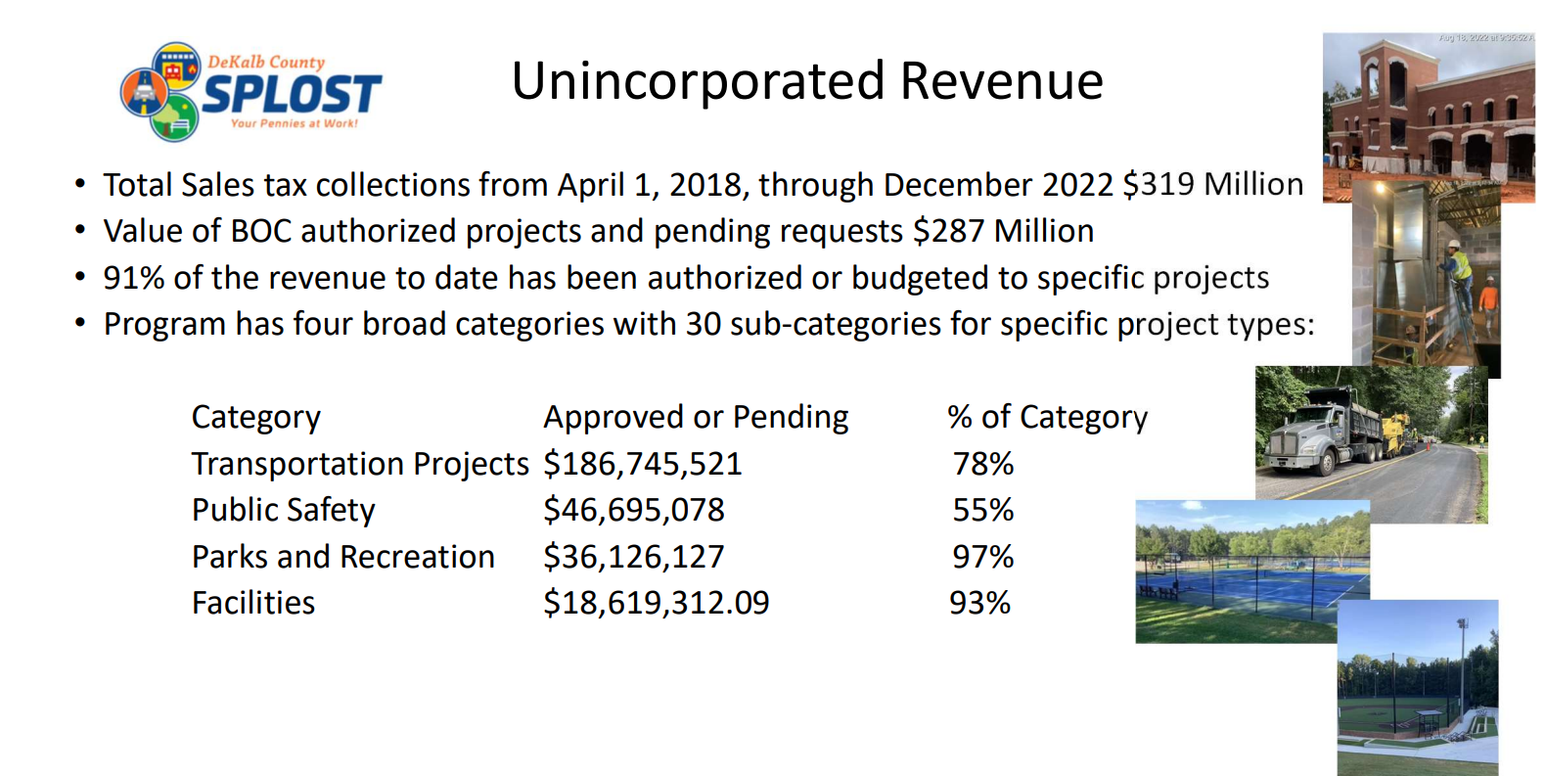
DeKalb County’s SPLOST 1 Program
SPLOST Committee of the Whole Meeting
April 20, 2023
Michael L. Thurmond, CEO
DeKalb County Board of Commissioners

Slide 2
Starting Point
What we Know

Slide 3
What is SPLOST ?
SPLOST (Special Purpose Local Option Sales Tax) is a one-cent sales tax that provides funding exclusively for capital projects – roads, building, infrastructure etc. DeKalb’s SPLOST 1 has some limits on which projects can be funded:
Transportation 85%
Capital Outlay - 15%

Slide 4

2016 SPLOST Survey Research Report GSU Andrew Young School of Public Policy
March 2016 – Top Priorities for Funding
Roads, Transportation, and Sidewalks – 54%
Public Safety – 21%
Senior Centers and Health Centers – 11%
Parks and Libraries – 10%
Don’t Know– 4%
(*) Summary of results when respondents were asked to list their top spending priority of the proposed sales tax.

Slide 5
DeKalb County SPLOST Vision Statement
“DeKalb County Special Purpose Local Option Sales Tax will support county-wide improvements that promote a high quality of life for all residents. “
Adopted by CEO and DeKalb BOC

Slide 6
Path to DeKalb County’s SPLOST 1 Program
JANUARY 2017 GA General Assembly convenes 2017 Legislative Session
JANUARY 2017 Senate Bill 156 is introduced. The bill restricts the use of SPLOST funds to Transportation 85% and Capital Outlay 15%
FEBRUARY 2017 SB 156 was amended to include exemptions for unprepared food sales and prescription drugs
FEBRUARY 2017 - DeKalb holds a joint Delegation meeting at the Capitol to review draft SPLOST and EHOST Legislation.
MARCH 2017
Senate Bill 156 passes the Georgia General Assembly on the final day of the Legislative Session
APRIL 2017
County Staff and Administration , assemble GSU survey analysis and begin need needs assessment plan
MAY 2017 - Governor Deal signs Senate Bill 156. DeKalb BOC, the DeKalb Delegation and the CEO attend the bill signing
MAY –SEPTEMBER 2017
DeKalb CEO and BOC host 9 SPLOST Vision Sessions at Manuel Maloof Administration Building. Public invited
SEPTEMBER 2017–
DeKalb executes robust SPLOST education campaign to all DeKalb Residents
SEPTEMBER 2017
On behalf of DeKalb , The Georgia Chamber Transportation Alliance begins the SPLOST Advocacy campaign
NOVEMBER 8, 2017
71% of Voters approve SPLOST ballot referendum
JANUARY 10, 2018
CEO, BOC & DeKalb Mayors jointly support SPLOST 6- year program at Manuel Maloof Auditorium. City Attorneys negotiate SPLOST IGAs
FEBRUARY 2018
CEO forms committee to develop scope of work for professional Program Manager and subsequent RFP solicitation
MARCH 2018 Based on best qualified and best pricing Atlas Consulting (formerly Moreland Altobelli) is awarded a 6 Year contract to manage DeKalb's 1st
APRIL 2018
County staff and Program Manager define and finalize project categories for CEO and BOC review and approval
APRIL 2018
County receives first SPLOST sales tax payment from the Georgia Department of Revenue
APRIL 2018 CEO and DeKalb BOC adopts SPLOST Citizen Oversight Group with appointments representing all Districts across the county

Slide 7
Defining Transportation Needs
DeKalb hosted SPLOST Public Vision Sessions
Residents, the Governing Authority and Transportation experts defined the county’s vision for transportation planning;
State of Good Repair
Smooth Streets
Safety for bikes, pedestrian, school routes
Bridges, intersections safe
Sidewalk and Trail connections improved

Slide 8
Defining Transportation Needs – 85%
Priority Programs:
Resurfacing - Roads in poor condition; rated 30 or worse, includes 318 miles in Unincorporated DeKalb
Pedestrian Improvements, Multi-Use Trails, Operational Enhancements, Corridor Beautification)
Category Budgeted Actual Results
Resurfacing $ $151,250,000 14,382,990 252 Miles Pedestrian Improvements $ 14,450,000 9,198,648 20 Projects/15 Miles
Multi-Use Trails $ 7,000,000 2,000,000 3 Miles
Operational Enhancements $ 9,000,000 2,800,000 9 Safety Projects
Corridor Beautification $ 1,250,000 895,000 3 Projects
Bridge Repairs $ 7,000,000 7,000,000 Cedar Grove Bridge
Sidewalks to Schools, Transit $ 4,000,000 1,000,000 12 Projects
Traffic Signal improvements $ 2,350,000 281,000 2 Projects
CID Matching funds $ 1,500,000 0 TBD

Slide 9
Defining Capital Outlay Needs – 15%
DeKalb hosted SPLOST Public Vision Sessions where Citizens, the Governing Authority and Infrastructure Experts defined the county’s vision for Capital Improvements
Priority Programs:
Capital Outlay - County buildings and structures needing repair because of deferred maintenance due to a historical lack of county funding. A robust SPLOST program will provide the much- needed funding.
Priority Budgeted Actuals Results
Parks $37,250,000 $31,159,000 New Synthetic turf, over 12park buildings
renovated, Sugar Creek Golf reopened
damaged and dangerous playground
equipment replaced, shelters repaired,
Toby Grant pool funded
Within parks, new roofs installed
Courthouse $16,500,000 $15,500,000 Roof, Chillers, elevators, Parking Deck
Libraries $ 1,500,000 New equipment at Decatur HQ, restrooms renovated
Senior Centers $1,000,000 $ 1,000,000 HVAC Upgraded at Lou Walker & Warren St
Health Centers $1,000,000 $ 1,000,000 North DeKalb and Richardson Health Centers

Slide 10
DeKalb’s SPLOST 1 Program is coupled with a Tax Credit called “EHOST”

Slide 11
What is EHOST ?
EHOST (the E is for Equalization) serves two purposes:
First, it removes any use of the funding for capital purposes. Each year, 100% of the revenue must be used to reduce property taxes for homeowners.
Secondly, it applies the revenue first to rollback millage rates levied countywide (General and Hospital currently).
If there’s enough total EHOST revenue to provide a 100% rollback of countywide property taxes, then any remaining funding can reduce taxes in cities and non-countywide districts.
How much was my home’s tax bill reduced as a result of EHOST ?
The amount will vary depending upon the value of your home and the jurisdiction in which you live.

Slide 12
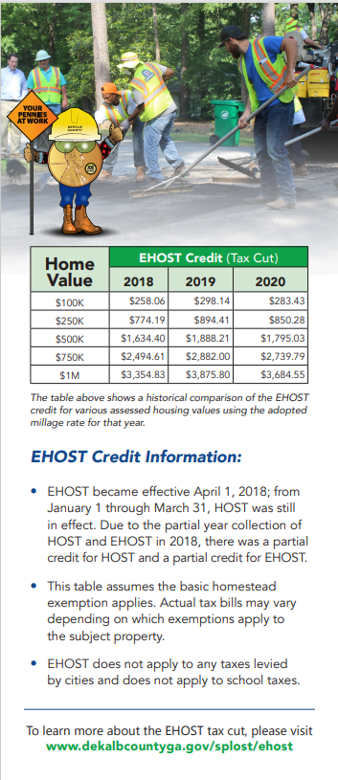
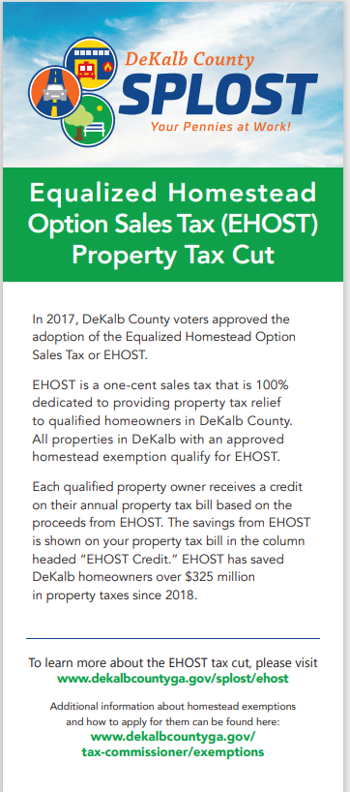
EXACTLY HOW IS EHOST IMPACTING MY TAX BILL ?

Slide 13
Communications

Slide 14
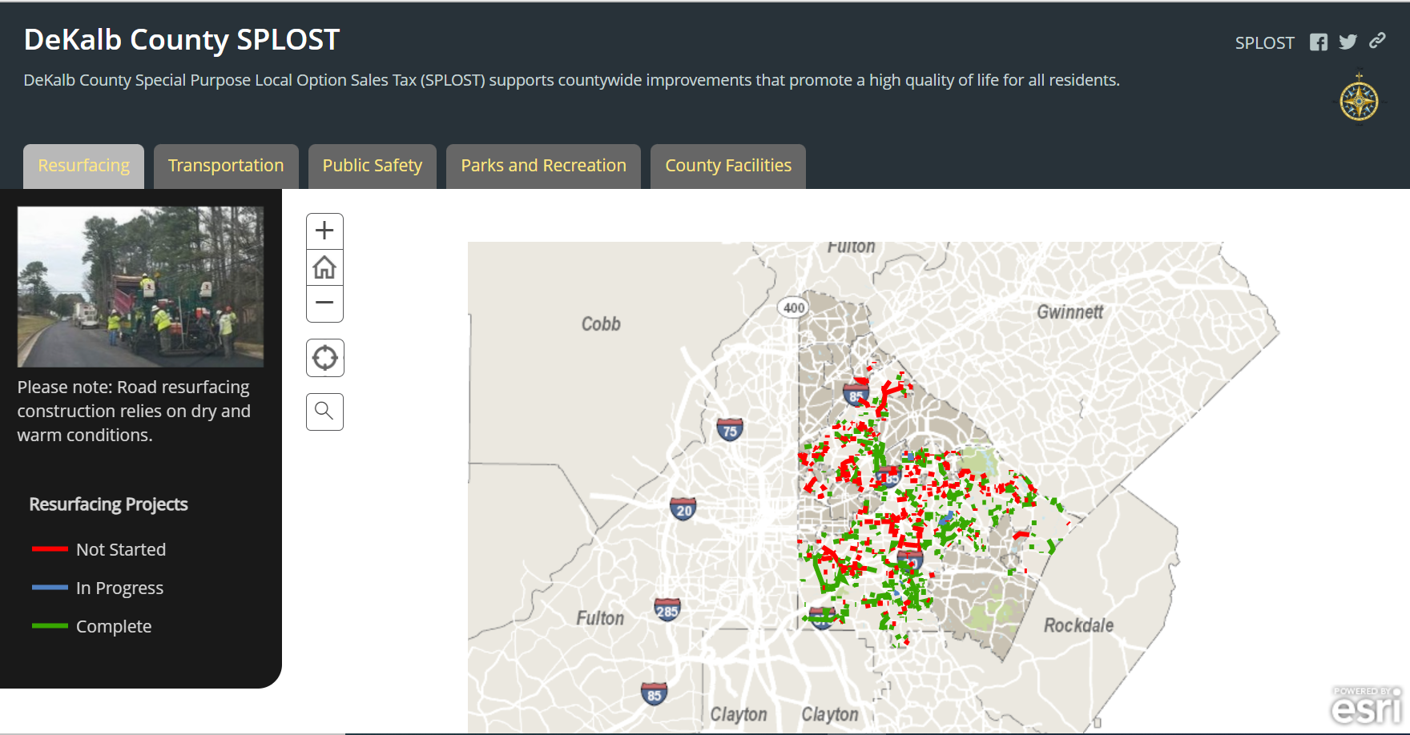
DeKalb residents have multiple tools to identify
SPLOST activities in your area
30 + News Releases and updates regarding SPLOST events and progress
65 + Social Media posts
SPLOST Oversight Group - Monthly and bi-monthly meetings are all recorded with minutes on website
DeKalb County Website: Home | DeKalb County GA

Slide 15
NEXT STEPS

Slide 16
Path to DeKalb County’s SPLOST 2 Program
JANUARY 9, 2023 GA General Assembly Legislative Session convenes
FEBRUARY 2023 HB 431 is introduced. The bill removes restrictions in SPLOST 1 and allows for Capital outlay
FEBRUARY - MARCH 2023 HB 431 Passed the House & Senate unanimously with a bi-partisan vote
FEBRUARY 2023 DeKalb Delegations both House and Senate hold meetings at the Capitol to review draft SPLOST and EHOST Legislation.
MARCH 2023
HB 431 passes the Georgia General Assembly 1 full week prior to Sine Die
TBD -2023 Governor Kemp signs HB 431 DeKalb BOC, the DeKalb Delegation and the CEO attend the bill signing
CEO Holds public Community meetings on SPLOST 2
Dates and locations to be provided

