Slide 1
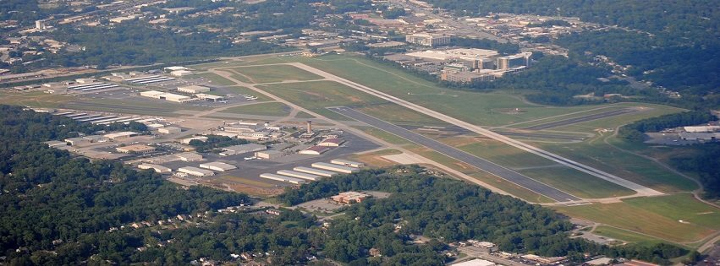
DEKALB – PEACHTREE AIRPORT Tree Mitigation Plan

Slide 2
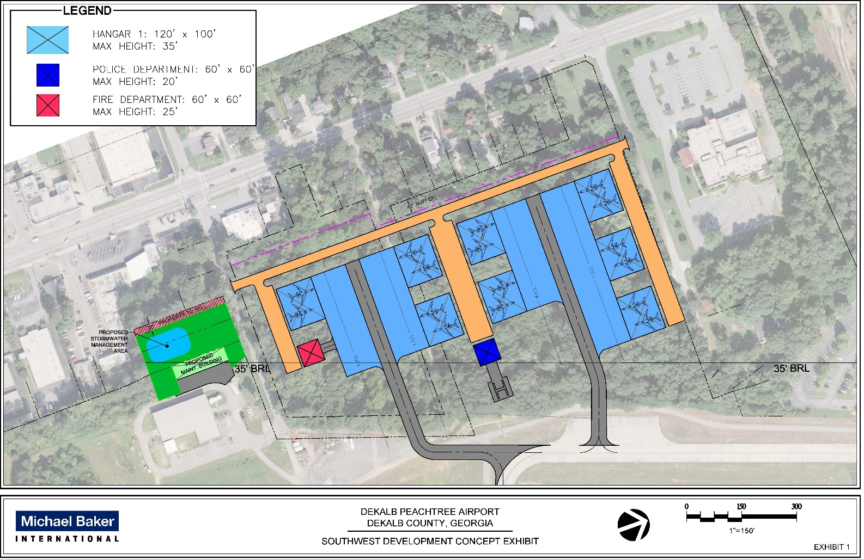
Proposed Concept

Slide 3
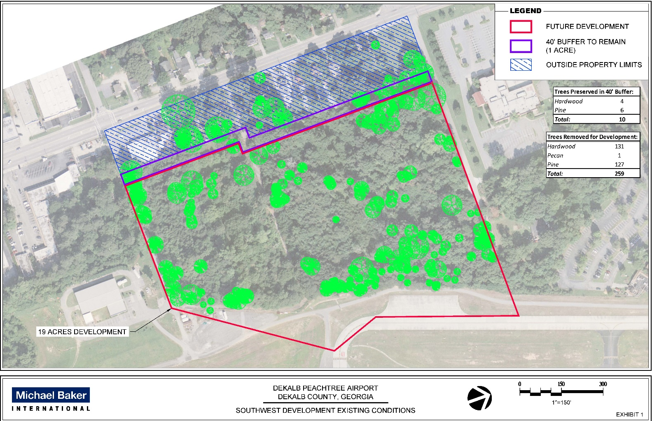
Existing conditions
290 Trees Surveyed
269 within development limits
10 trees preserved in 40’ buffer
259 trees removed for development

Slide 4
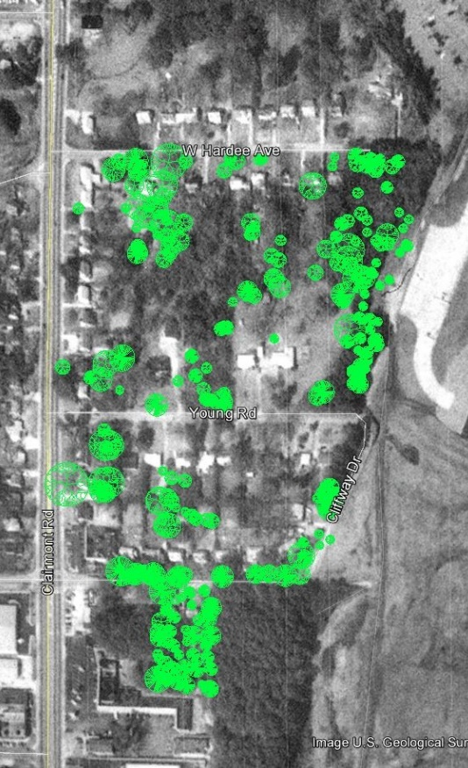
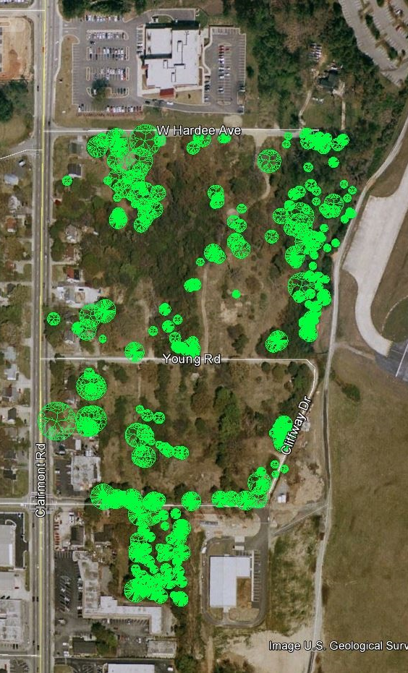
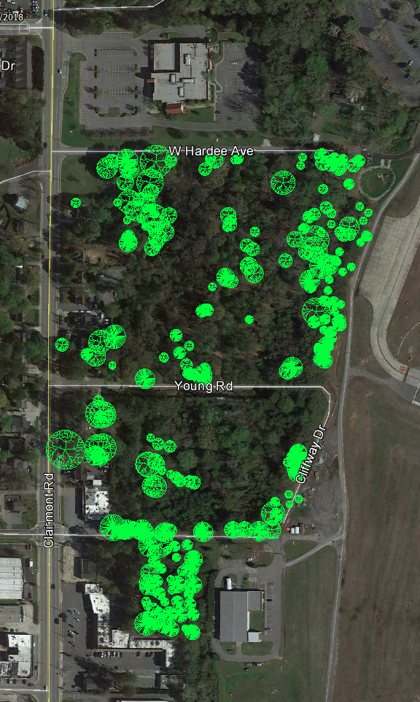
Existing conditions
1992
2002
2018

Slide 5
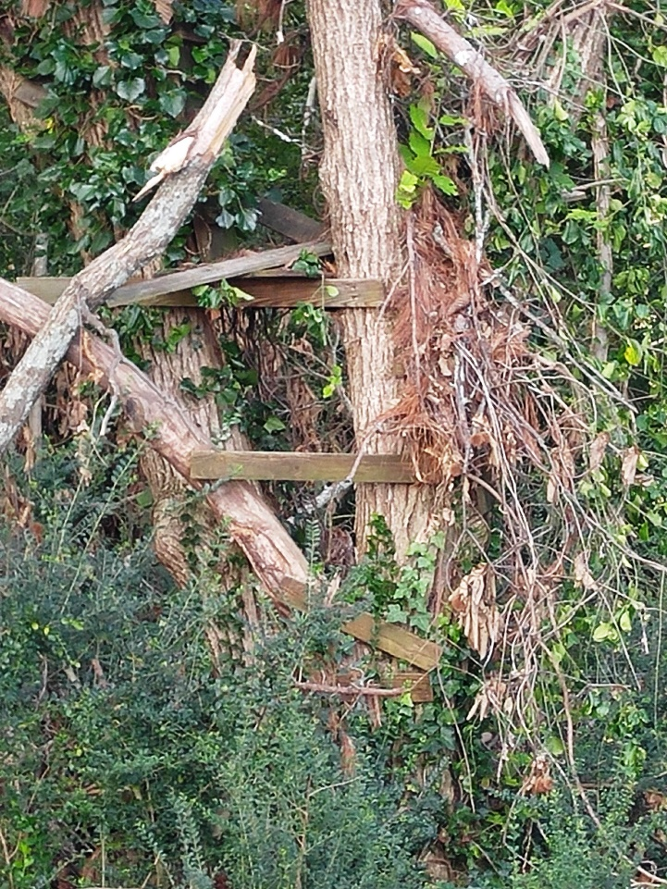
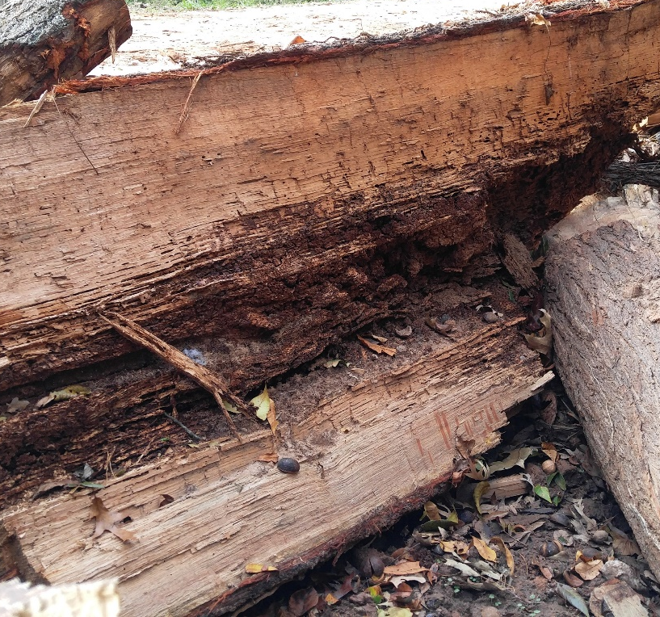
For a tree to be in “fair” or “better” condition to be inventoried it must meet the minimum standards:
Life expectancy greater than 15 years
Structurally sound trunk
No more than one major dead limb
No major insect problem

Slide 6
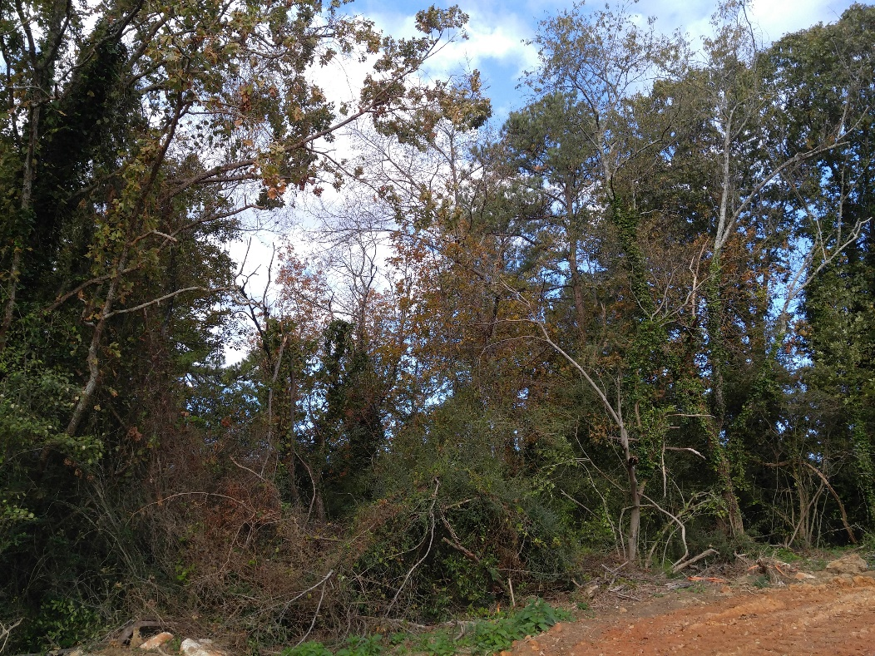
Current Conditions:
Shrubbery and Overgrowth
290 Trees that are strong, healthy, and in fair or better condition

Slide 7
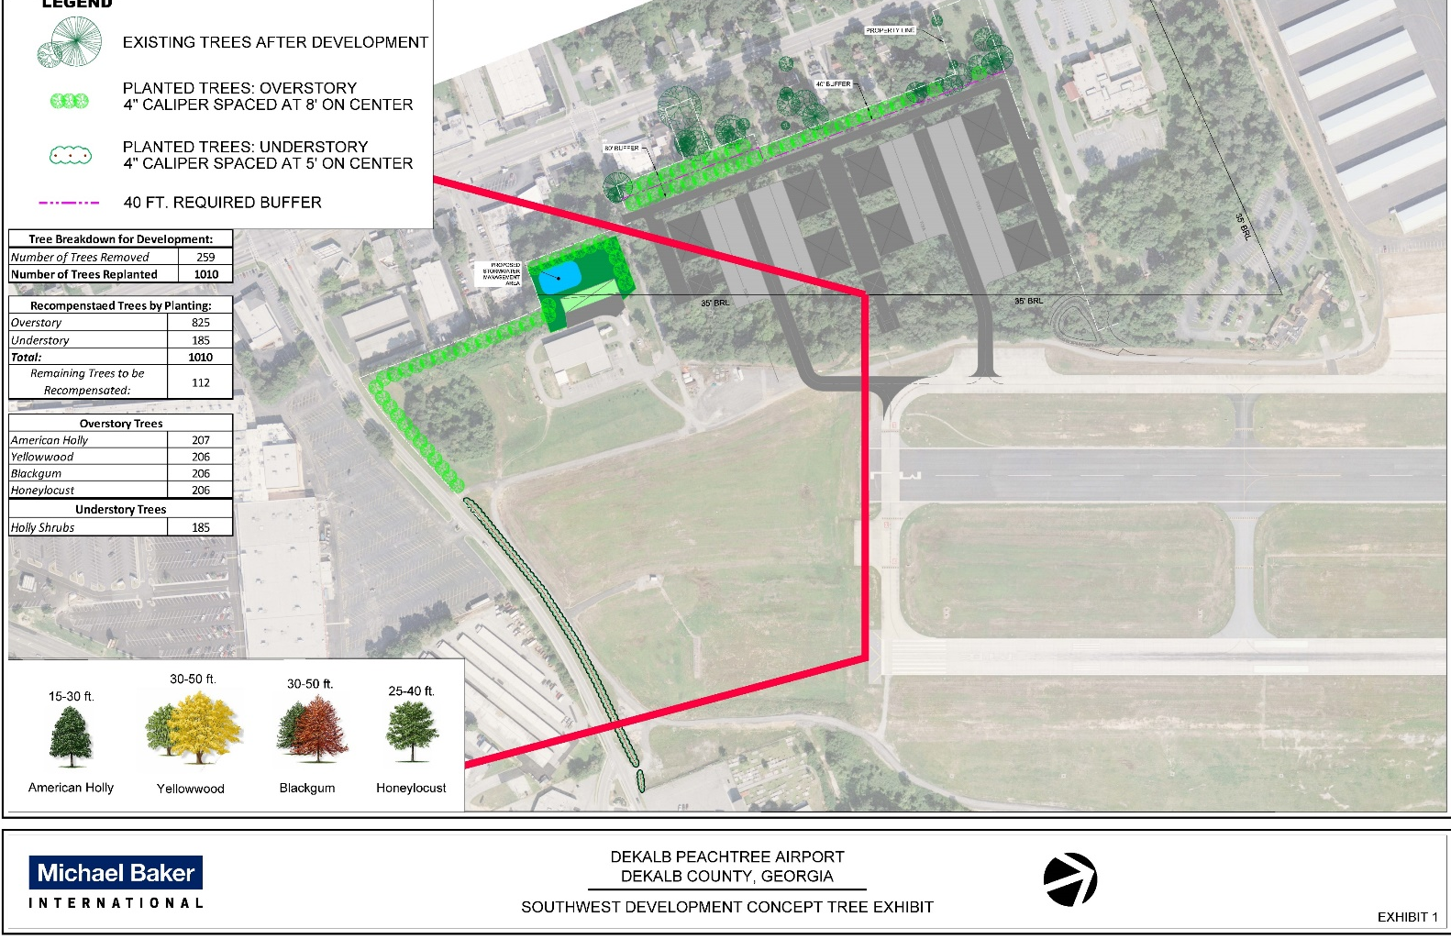
Removed 259 trees
Required to replant 4486” in diameter
1010 Trees to be planted on Airport Property
112 Trees to be financially compensated
(Recommended)
1122 Required 4” Caliper trees
Proposed mitigation plan

