Slide 1
Hotel, Motel and Extended-Stay Hotel Ordinance
Presentation to PECS Committee
Luz Borrero
Deputy Chief Operating Officer for Development
June 27, 2017

Slide 2
Proposed ordinance provides regulations that improve quality of life for Hotels/Motels and Extended Stay Patrons and surrounding area Residents
Purpose
To ensure the continued availability of quality transient lodging within the County, proper maintenance of hotels, motels, and extended-stay hotels and to protect the health, safety and welfare of hotel, motel, and extended-stay hotel inhabitants.
Chapter 18, Nuisances
To address the impact on the community for quality transient lodging, this ordinance has been placed in Chapter 18 with reference to other chapters as they may relate more closely to zoning or other aspects of the code.
The ordinance establishes new regulations or strengthens existing regulations by:
Establishing length of stay in hotels, motels, and extended-stay hotels
Outlining security approaches
Setting standards for regular sanitation and cleanliness of rooms and premises
Providing for record-keeping and other transparency processes to assist with enforcement
Requiring life safety, sprinklers, and fire alarms are installed and functioning
Allowing Right of Entry to Code Officials when there is probable cause requiring an inspection

Slide 3
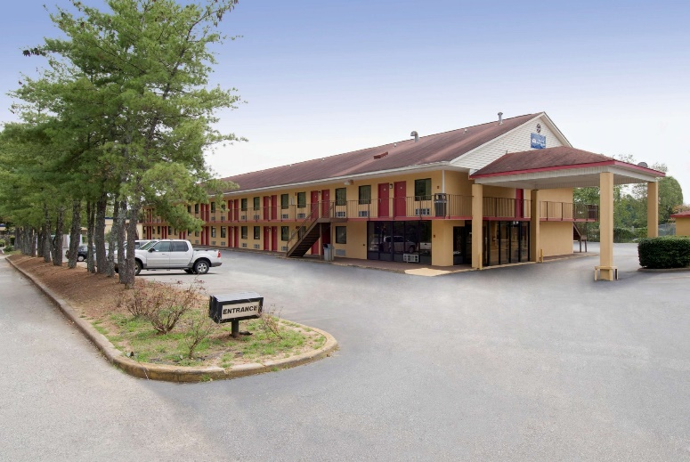
Ordinance Vetted with DCVB and Hotel/Motel Task Force
Welcome to Atlanta's DeKalb County | 1-866-633-5252
The DeKalb Convention and Visitors Bureau created a task force composed of hotel/motel owners to review and provide feedback on the proposed legislation
Representatives from the administration, and Planning, Police and Fire Departments met with DCVB and task force members to discuss and address concerns and agree on new language when warranted
The legislation draft was modified to ensure new regulations were not excessively onerous to owners as to have a deleterious impact on the hotel/motel and tourism industry as a whole in DeKalb County

Slide 4
Proposed Ordinance Clearly defines Hotel, Motel and Extended Stay Hotel and Regulates Length of Stay
“Hotels” or “Motels” defined as any structure consisting of one or more buildings, with more than five dwelling units with provisions for transient living, sanitation, and sleeping where temporary lodging of 30 days or less is offered for pay and is not intended for long-term occupancy.
“Extended-Stay Hotels” defined as structures with more than five (5) dwelling units with provisions for living, sanitation and sleeping that are utilized for temporary residence by persons for non-transient extended stays or stays longer than 30 days.
Stays greater than one hundred twenty (120) days at an Extended-Stay Hotel prohibited except when:
1. A written contract or documented agreement exists between an extended-stay and a business, corporation, firm or government agency.
2. Documentation, consistent with HIPPA privacy rules, confirms a hotel guest is considered family or caring for a patient admitted in a local hospital.
3. Where a hotel guest has been relocated from their home by a natural disaster or fire.

Slide 5
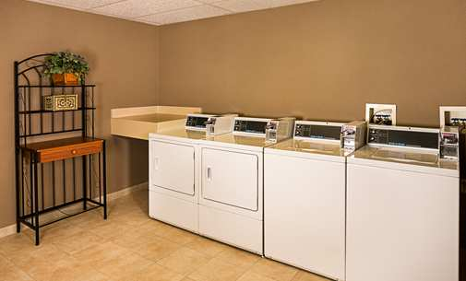
Provisions in the proposed ordinance increase responsibilities of hotel owners
Hourly rentals are prohibited
All handicap parking must be in compliance with state and local laws
All vehicles parked on any hotel’s premises must be in good working order
All newly-constructed hotels, motels, and extended-stay hotels must have magnetic or electronic keycard/locking devices for access to public entry points
All newly constructed extended-stay hotels must have the following:
Enclosed, heated and air conditioned laundry space containing at least three clothes washers and three clothes dryers for guests
Minimum of one thousand (1,000) square feet for recreational use by guests

Slide 6
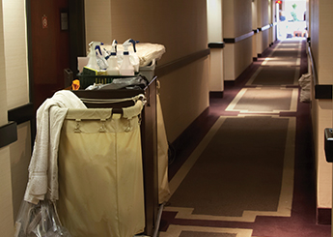
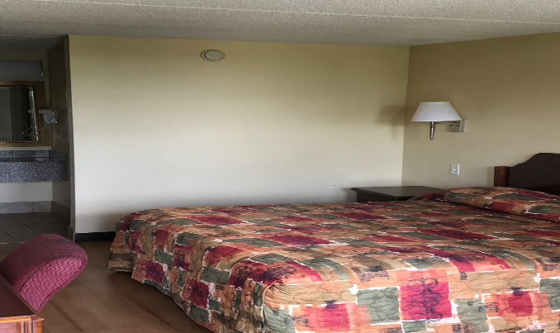
Legislation addresses high incidence of sanitation related violations by setting a minimum standard for room cleaning
Requires housekeeping to be included in room rate. Rooms must be cleaned before new guests check in and no less than once every seven (7) days.
Each hotel, motel, and extended-stay hotel must maintain a log that documents when each room is cleaned. The log must be maintained for 120 days for extended-stay hotels and must be maintained for 30 days for hotels and motels.
Setting a minimum standard for Sanitation in Hotels, Motels and Extended-Stay hotels will decrease the incidence vermin infestation and increase quality of life in these establishments

Slide 7
Strengthened security measures and record-keeping requirements will assist police and other enforcement officers
Proposed ordinance includes strong reporting and record-keeping requirements
Must maintain a record of the hotel guest’s vehicle information
Must keep a record of all rental agreements between the hotel and all patrons and their guests, for no les than 180 days after the rental agreement
All Hotel, Motel, Extended Stay Hotel owners are required to report violations of law to the DeKalb County Police Department that were either witnessed or made known to them by an employee, patron, guest, visitor or other person on the premises.
Additional security requirements will protect patrons
Exterior doors (other than lobby doors) must be locked between the hours of 9:00 pm and 6:00 am and shall be equipped with an alarm
A Video Surveillance System (VSS) must be installed within one year of the effective date of this ordinance. All VSS shall have no less than one camera dedicated to each register or check–out stand, entrance/exit, interior hallway and lobby, swimming pool area, exercise facility, loading dock, and parking lots or areas designated for customer and/or employee parking use.
A security guard or security fencing must be in place

Slide 8
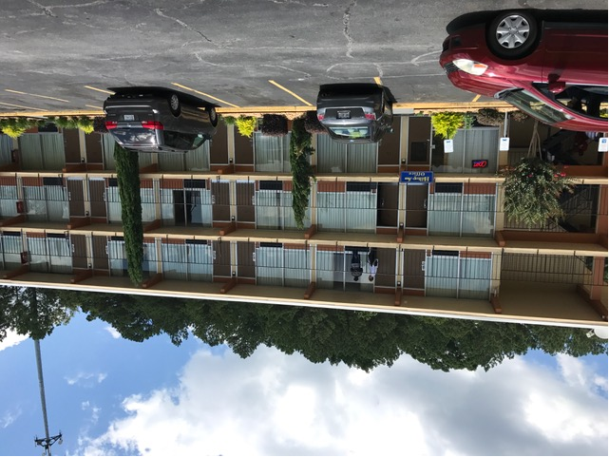
Proposed ordinance reduces fire risk to hotel guests by strengthening requirements for smoke detectors and sprinkler systems
The proposed ordinance requires existing and newly constructed hotels, motels and extended-stay hotels to be brought into compliance with sprinkler requirements required by state law for new construction
Two Year extension allowed if hotels implement a “no smoking” policy and have no kitchen facilities within 60 days.
Sprinkler systems not required in buildings where door opens outside at the street of finished ground level; exterior exit access is arranged in accordance with NFPA in buildings three (3) stories or less
New and existing hotels, motels, or extended-stay hotels are required to be equipped with a hard wired smoke detector or tamper-proof, ten year smoke alarms
All smoke detectors or alarms must be installed and approved by the Fire Marshal within one hundred and eighty (180) days after the effective date of this ordinance.

Slide 9
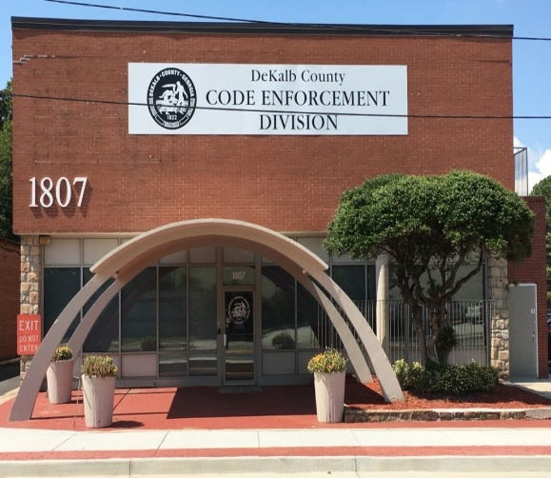
The ordinance will be enforced by Police, Fire, Code Enforcement, and Health Department Officials
All hotels, motels, and extended-stay hotels are required to operate in compliance with all zoning, building code, fire safety code, health code, and other ordinances and laws of the county and the state.
Any hotel, motel, or extended-stay hotel that is found to be in violation of certain provisions in this ordinance may be declared to be unlawful and a public nuisance. The county will have the authority to commence actions or proceedings for abatement, removal or enjoinment provided by state law and the DeKalb County Code of Ordinances.
Authorized sworn officers may inspect establishments governed under this section during the hours in which the premises are open for business.

Slide 10
Next Steps
Gather any additional input/changes
Incorporate changes into final document
Further legislation for approval to BOC

Slide 11
Thank You!

